Slide 1
Demo - Assessment of Computational Thinking Skills
Kevin Yeong Yu Heng
A0143487X
Project Supervisor: Dr. Bimlesh Wadhwa

Slide 2
Code Repo
The project code can be downloaded from the following source
https://github.com/gnoeykeCG4001/sb3Analyzer

Slide 3
SB3Analyzer Demo

Slide 4
Setting up SB3Analyzer

Slide 5
Setting up SB3Analyzer
Ensure Python 3.8.0 is installed

Slide 6
Setting up SB3Analyzer
In "main.py" :
assign value <filepath> to the variable "sb3filepath"
where <filepath> refers to the full path and filename of the Scratch Project to be analyzed

Slide 7
Setting up SB3Analyzer
In "sb3analyzer.py" :
in the initialization function (__init__) of the SB3Analyzer Class, place the code for the assessment to be done.
example functions are provided in the comments

Slide 8
Example – Generating Textual Code

Slide 9
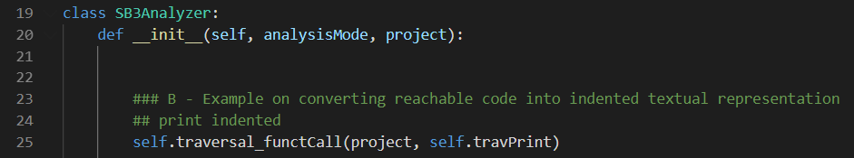
Generating Textual Code
In "main.py" : (using CatJumpJump.sb3 example project)
sb3filepath = “C:\Users\user\sb3analyzer\CatJumpJump.sb3”
In "sb3analyzer.py" :
Execute “runMain.bat"

Slide 10
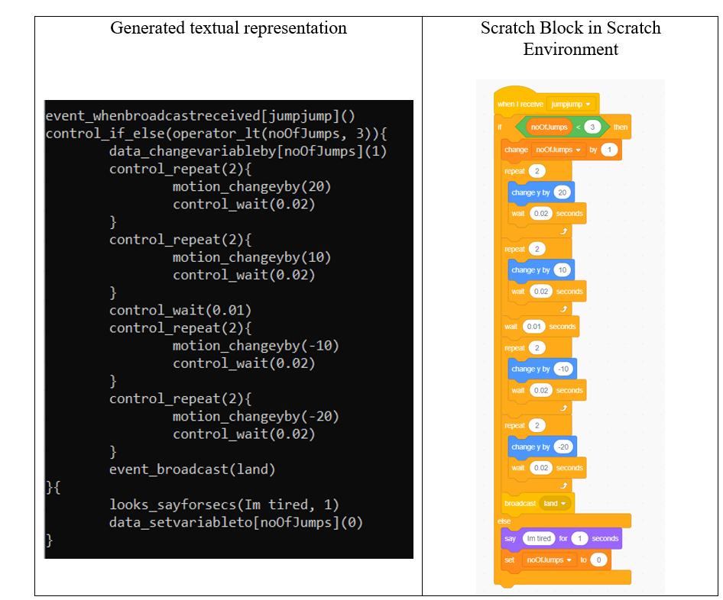
Generating Textual Code - Results

Slide 11
Example – Listing Unreachable Code

Slide 12
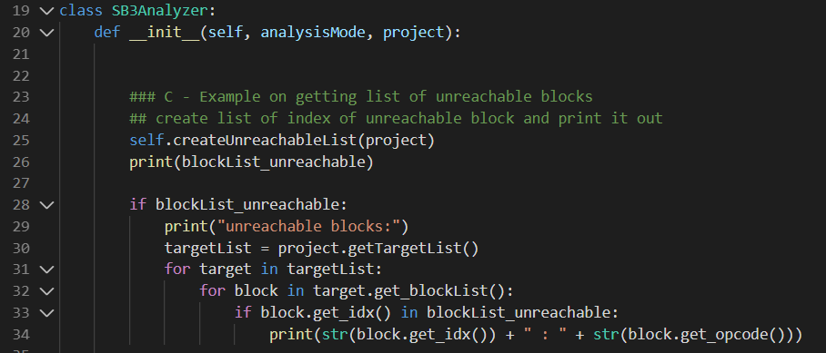
Listing Unreachable Code
In "main.py" : (using tmpUnreachableCode2.sb3 example project)
sb3filepath = “C:\Users\user\sb3analyzer\tmpUnreachableCode2.sb3”
In "sb3analyzer.py" :
Execute “runMain.bat"
This chunk of code is included for this example to see which block type is unreachable (it can be omitted)

Slide 13
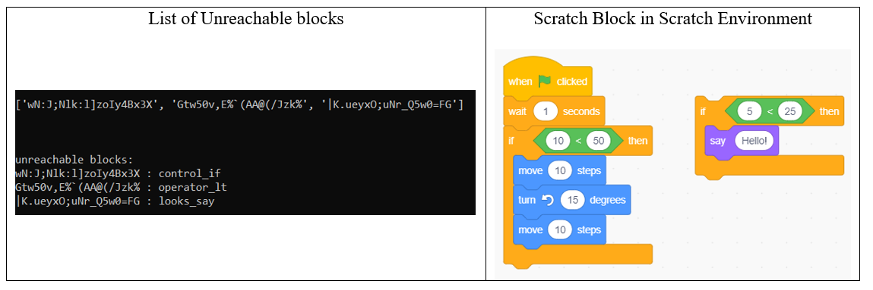
Listing Unreachable Code - Results
Unreachable code

Slide 14
Example – Listing Matching Code

Slide 15
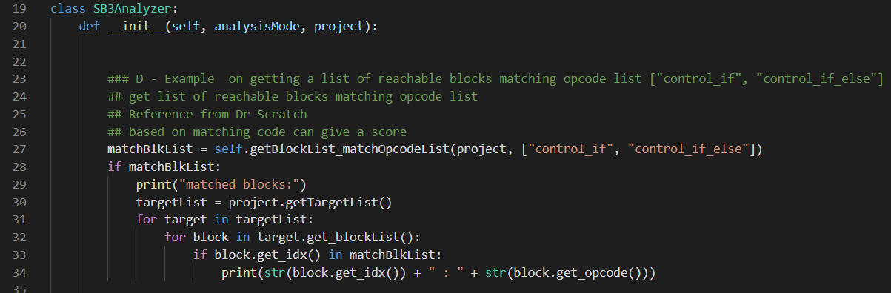
Listing Matching Code
In "main.py" : (using CatJumpJump.sb3 example project)
sb3filepath = “C:\Users\user\sb3analyzer\CatJumpJump.sb3”
In "sb3analyzer.py" :
Execute “runMain.bat"

Slide 16
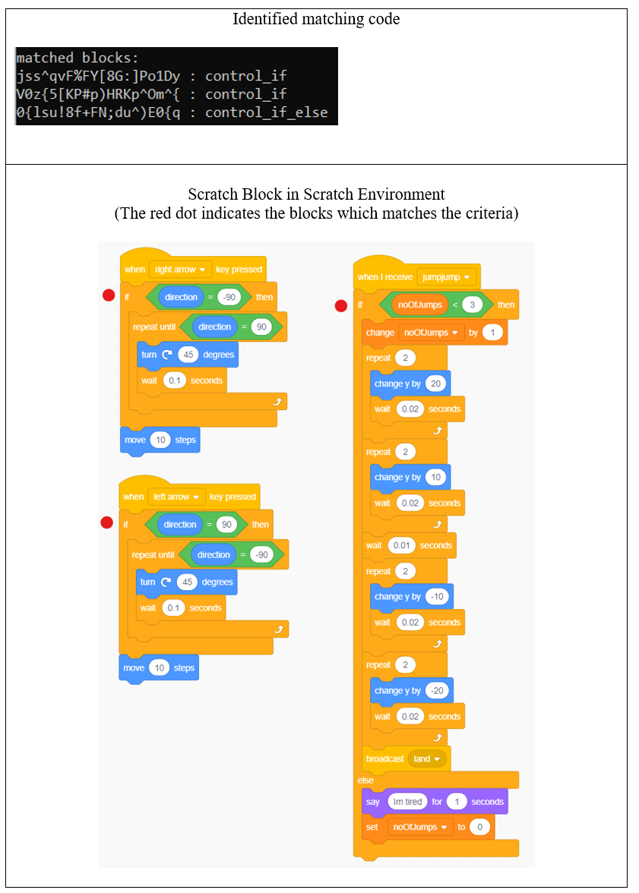
Listing Unreachable Code - Results

Slide 17
SB3Analyzer Code Guide

Slide 18
Notable chunk of the code
This section is a guide on the functionality on more complicated chunks of code

Slide 19
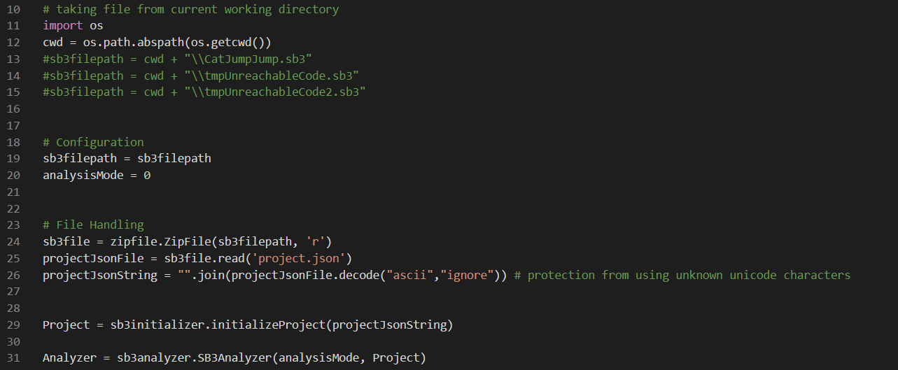
main.py
Full file path of the Scratch project
Creation of internal Project object
Creation of internal Analyzer Object

Slide 20
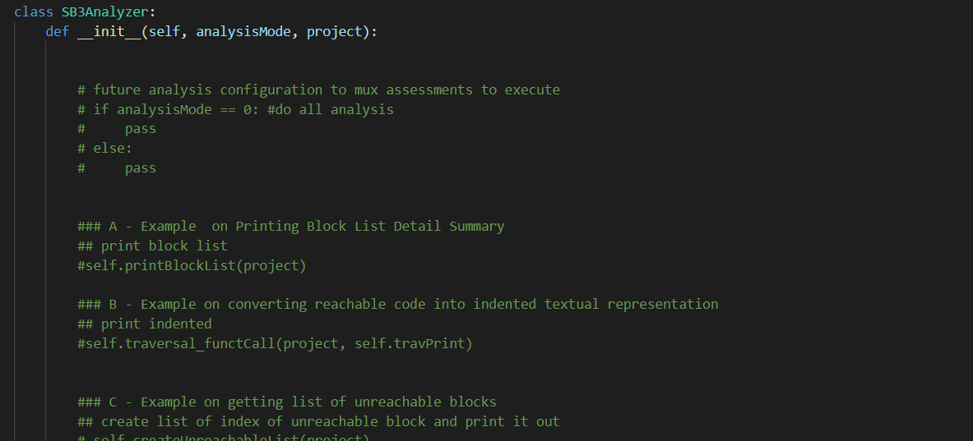
sb3analyzer.py
Code which does analysis

Slide 21
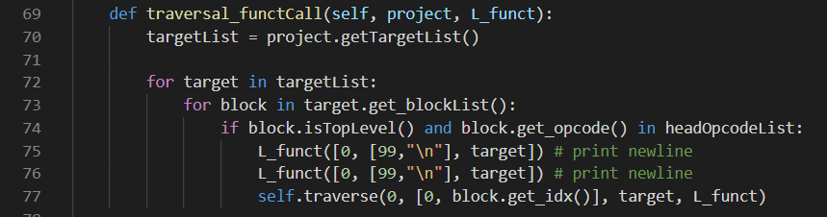
sb3analyzer.py
Function which starts the traveresal through the project in steps
Within each step does a function L_funct (L_funct is passed as a parameter)

Slide 22
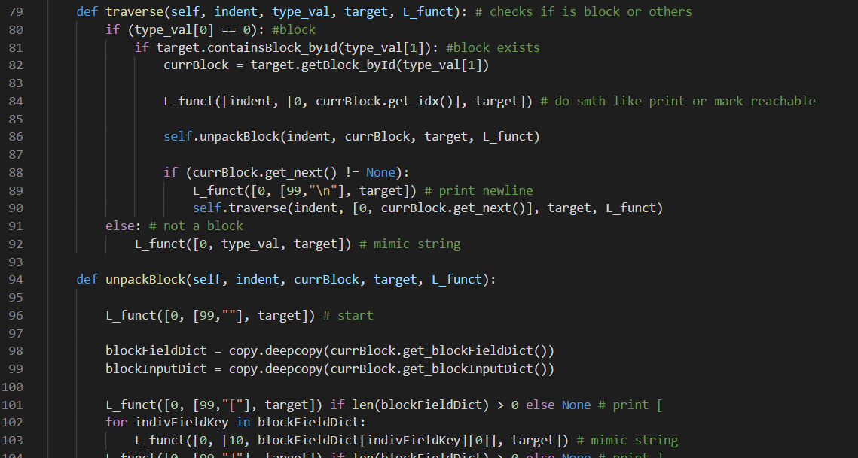
sb3analyzer.py
Functions which runs recursively to traverse through blocks
Within each block it unpacks the fields and inputs of the block, thereafter traverse to the next block

